Slide 1
Introduction to Robotics using Lego Mindstorms EV3
Shreya Reddy & Kiran Raja
RoboAvatars Robotics Team FTC7303
Roboavatars.com roboavatarsftc@gmail.com

Slide 2
Robotics using EV3
Are we ready to go Roboticists…?
Does each group have at least one laptop?
Do you have EV3-G software installed on the laptop?
If you have a question at any time please raise your hand and we will help you

Slide 3
Robotics using EV3
What is a Robot?
What are some of the robots you know..?

Slide 4
Robotics using EV3
What is a Robot?
A robot is a powered system that can perform specific tasks by itself without human help

Slide 5
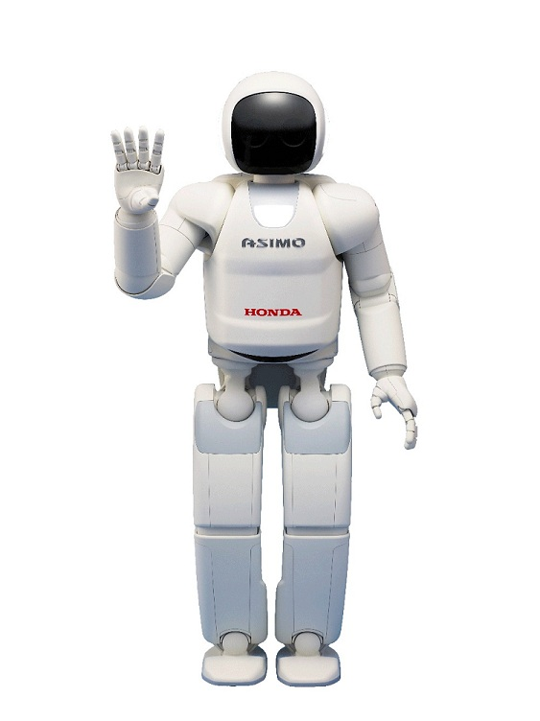
Robotics using EV3
Some well known robots (Real and Fictional)

Slide 6
Robotics using EV3
Some well known robots (Real and Fictional)

Slide 7
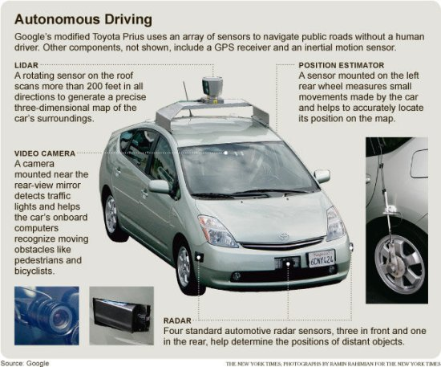
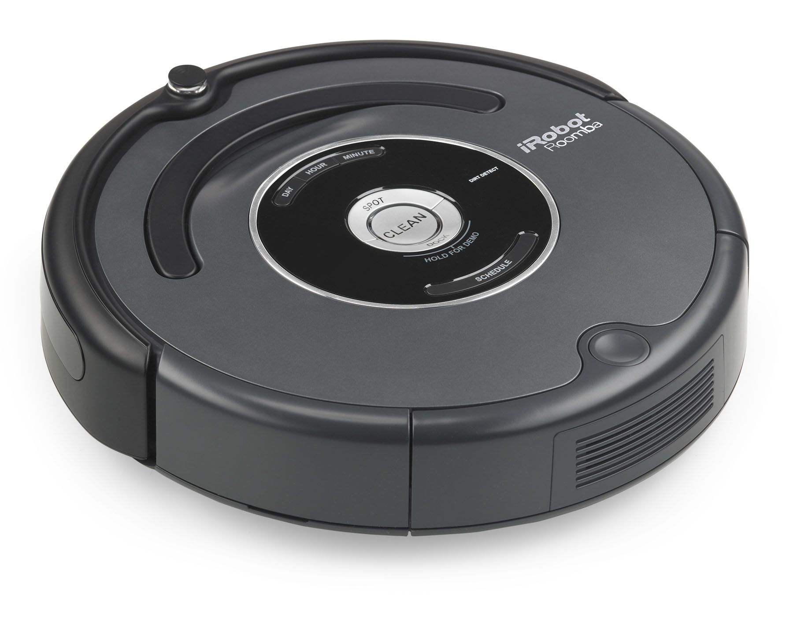
Robotics using EV3
Some well known robots (Real and Fictional)

Slide 8
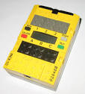
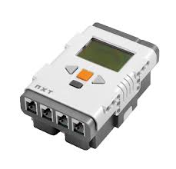
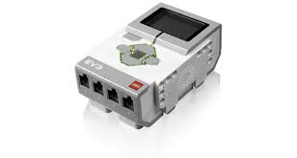
Robotics using EV3
Who built the Mindstorms EV3?
EV3 is built by that you all know and love…
Originally introduced as RCX in 1998
2nd generation NXT released in 2006
3rd generation EV3 released in 2013

Slide 9
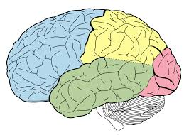
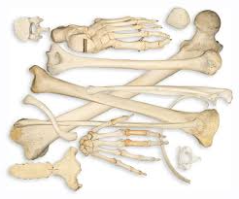
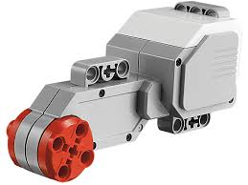
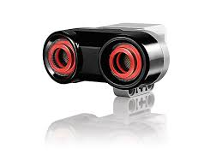
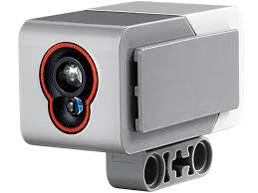
Robotics using EV3
Parts of a Robot (Human analogy)
Power source
Controller
Structural elements
Motors
Sensors

Slide 10
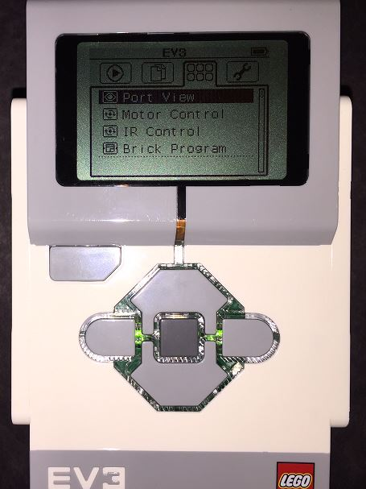
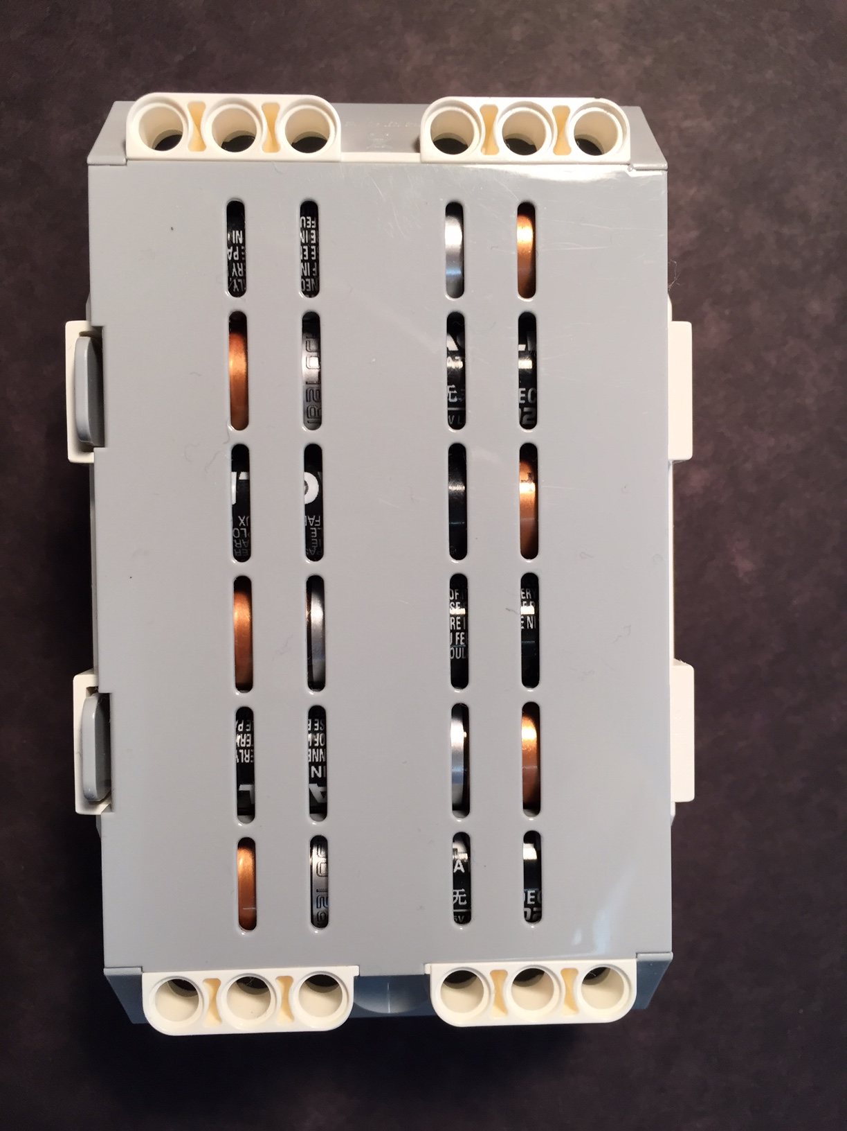
Robotics using EV3
The EV3 Brick
Brick name
Battery power
Screen tabs:
Recent programs
File navigation
Applications
Settings
Select button
Up/Down and Left/Right buttons
Back button

Slide 11
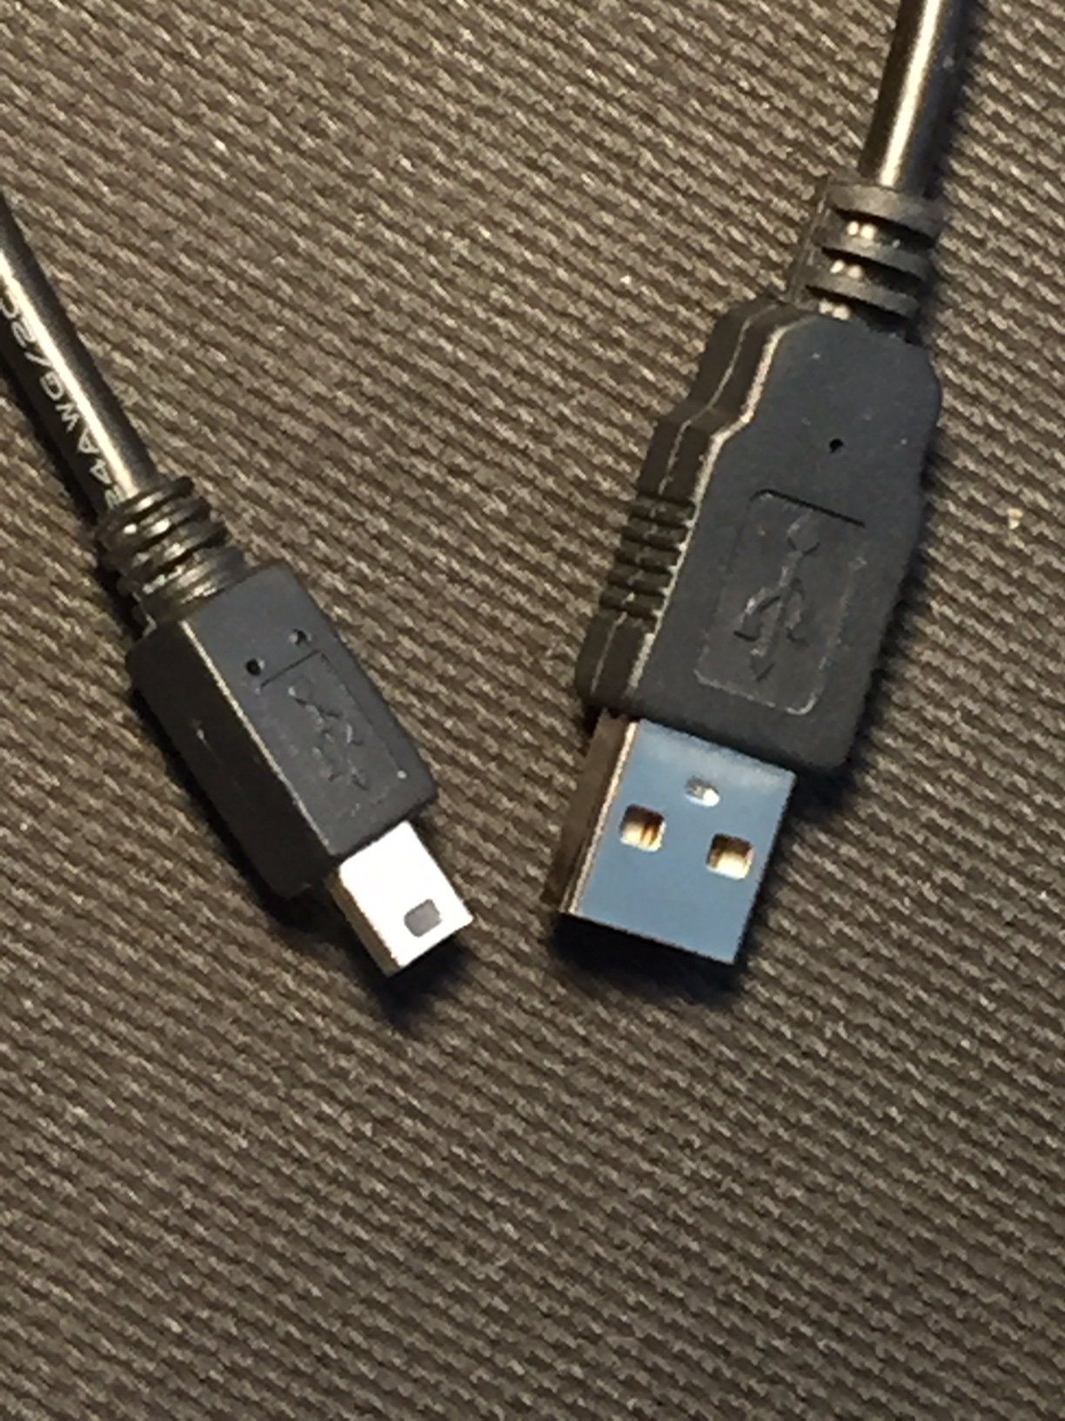
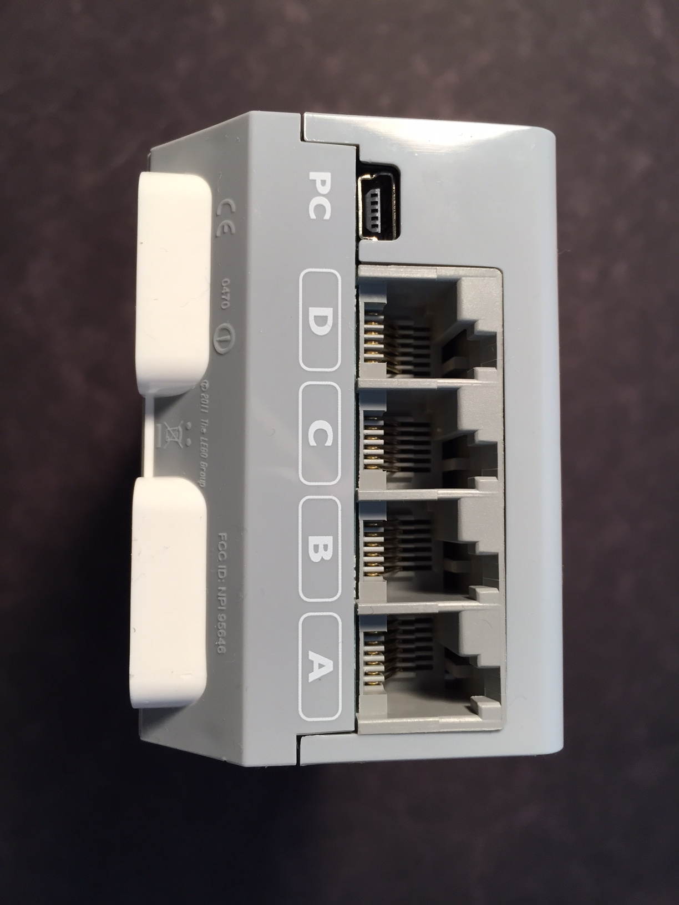
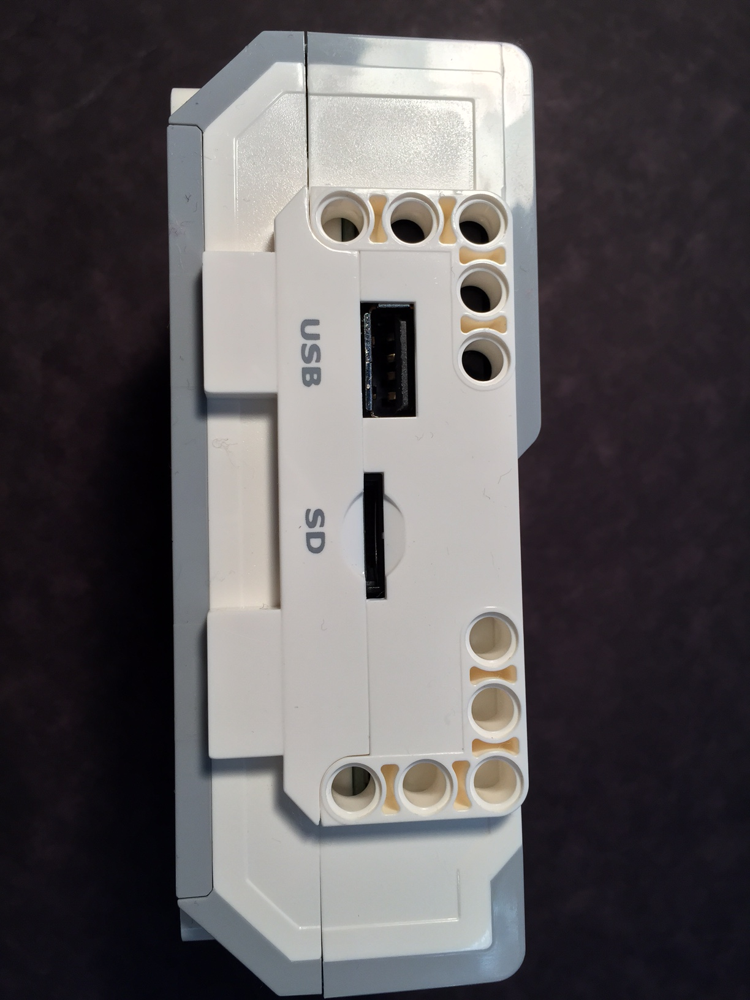
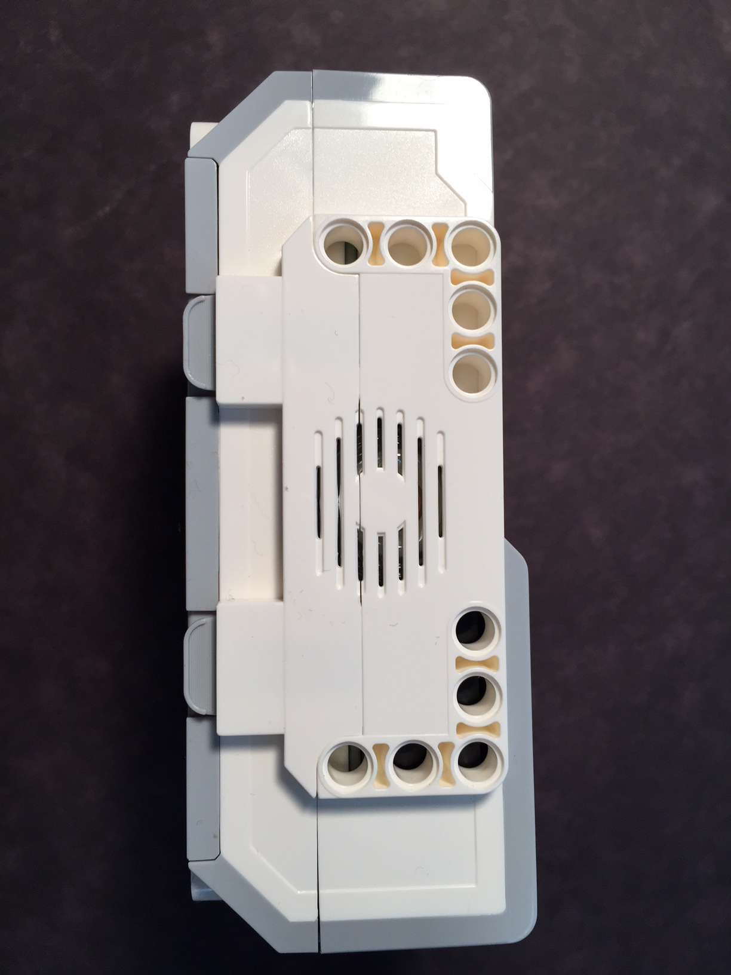
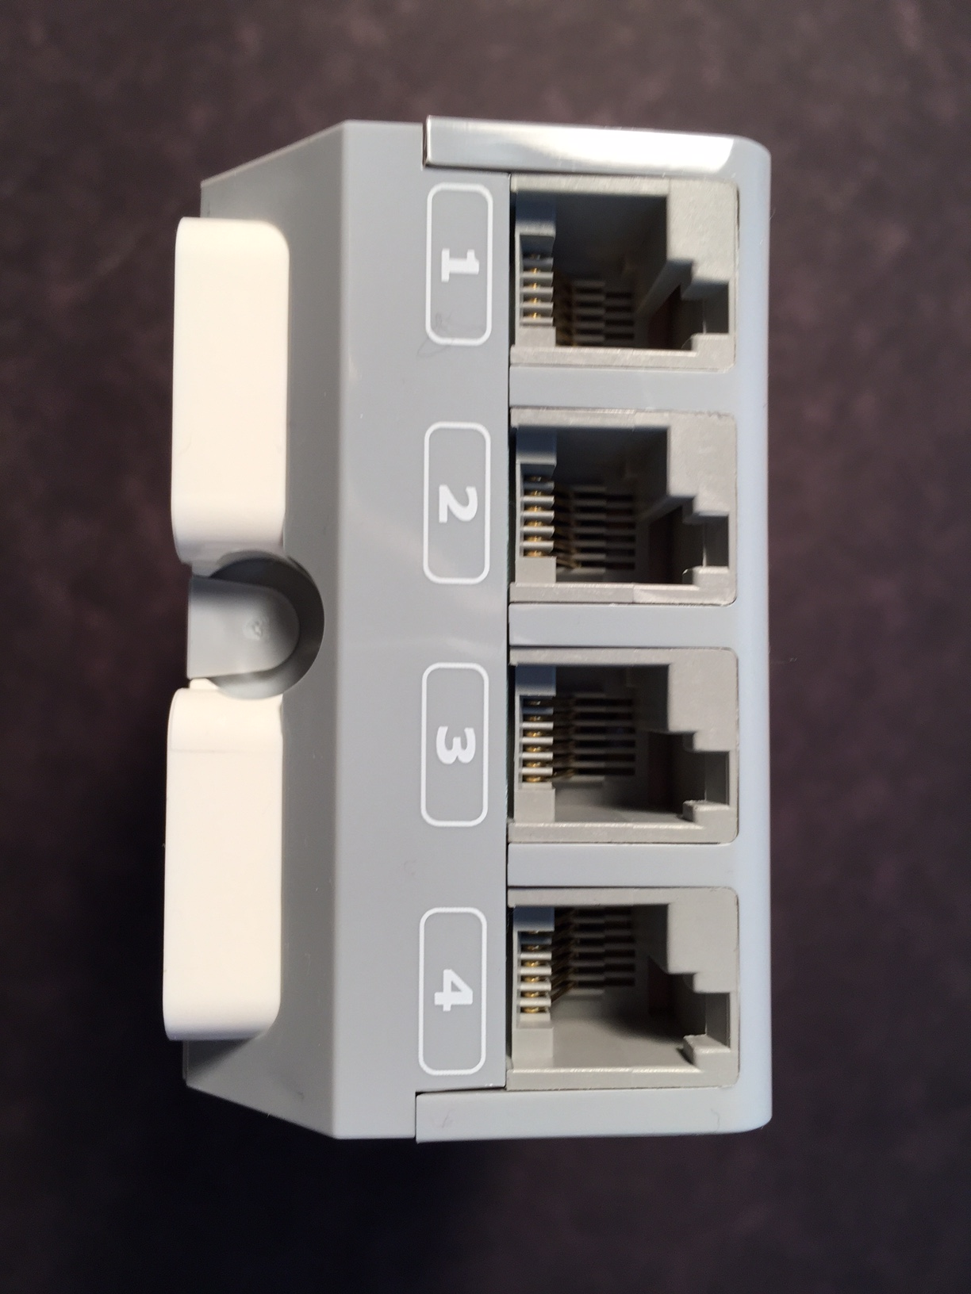
Robotics using EV3
The EV3 Brick
Micro USB to PC
Motor ports
USB download cable
USB slot
SD Memory slot
Speaker
Sensor ports

Slide 12
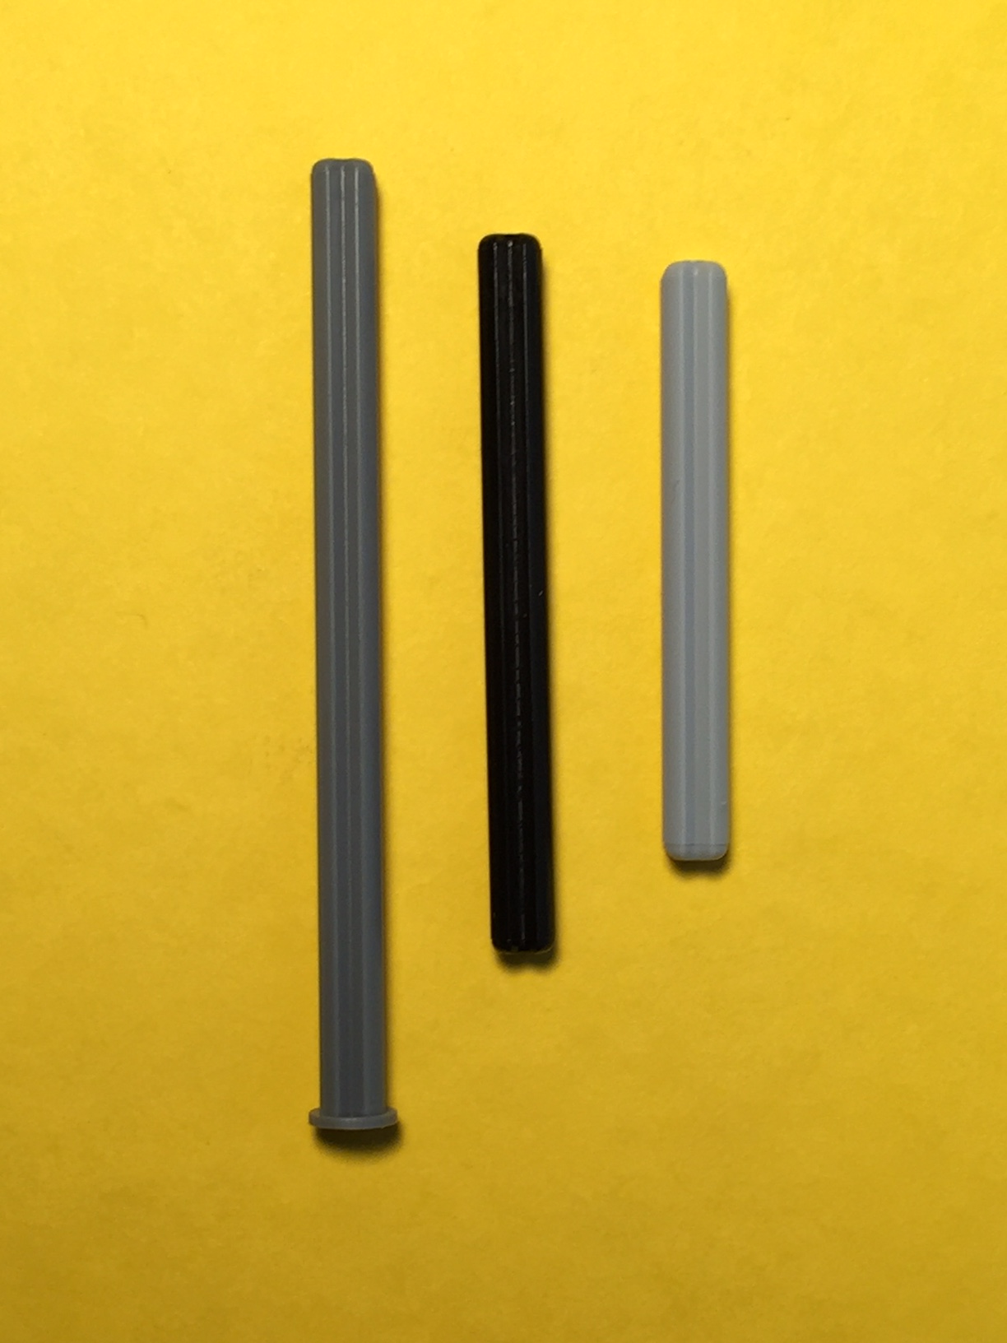
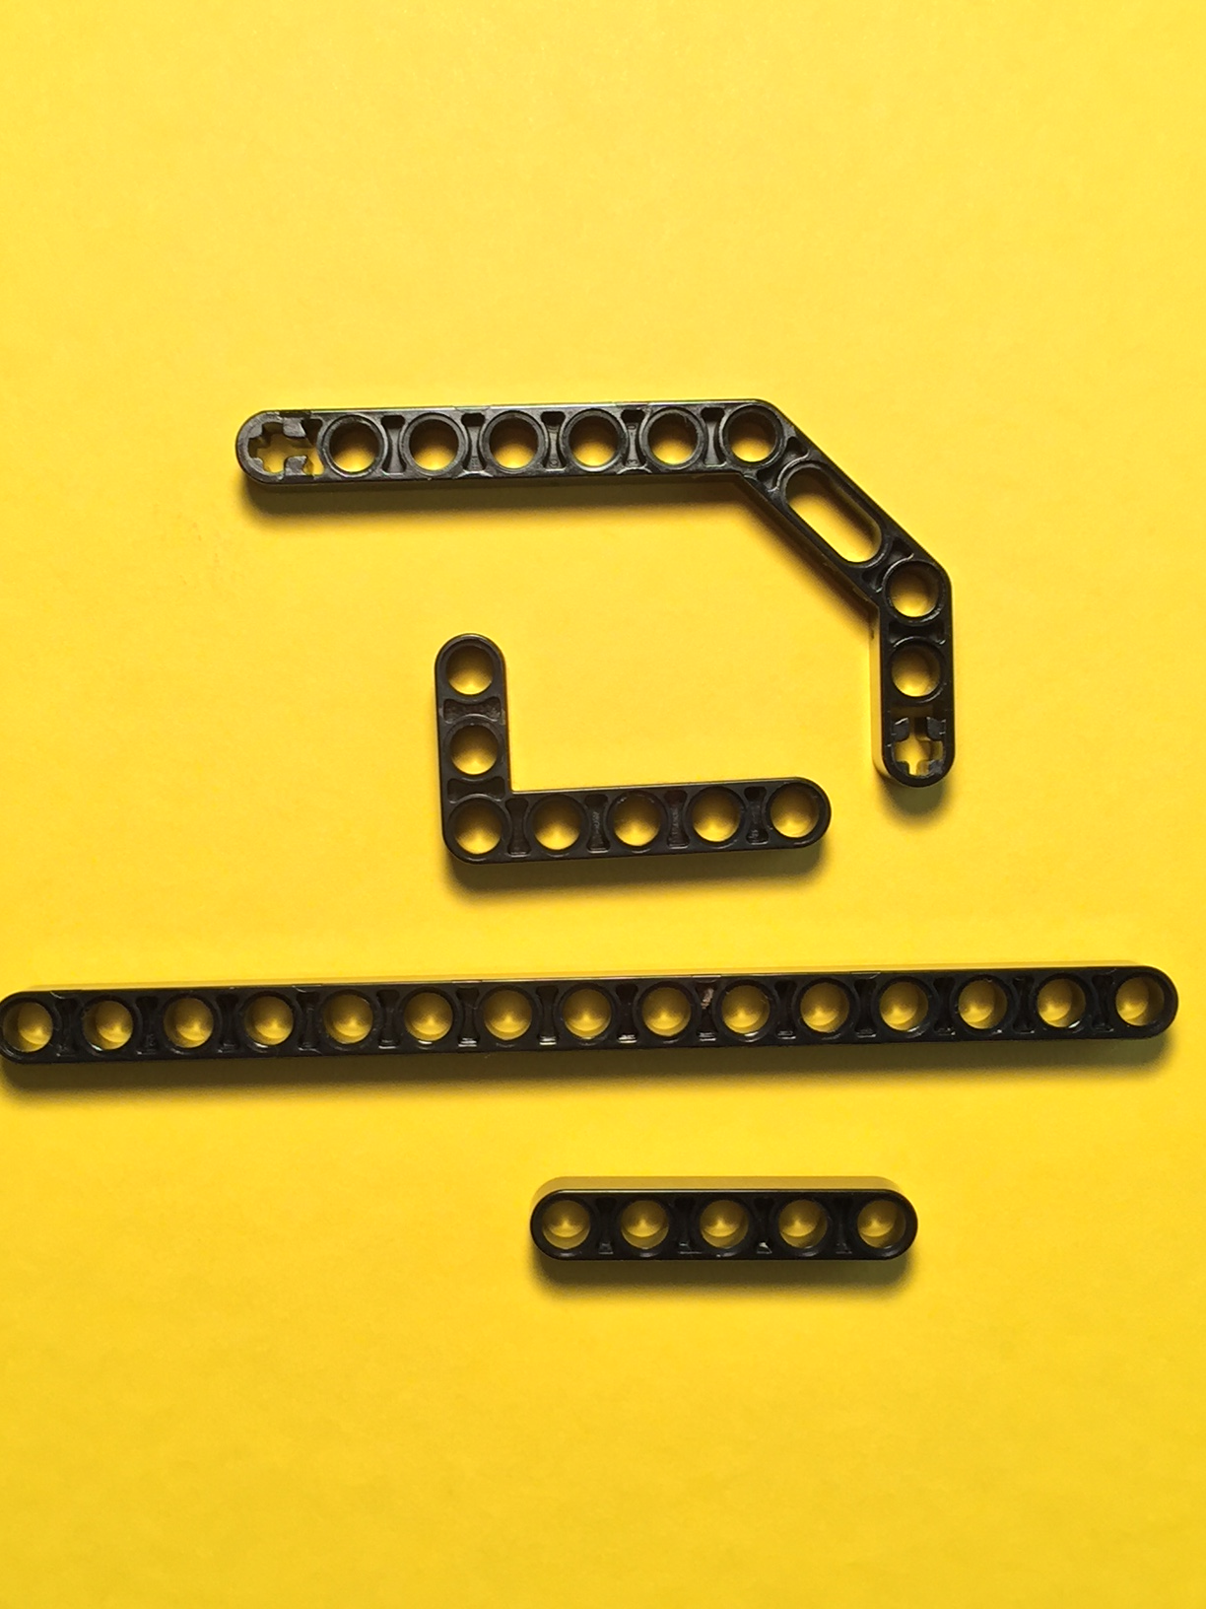
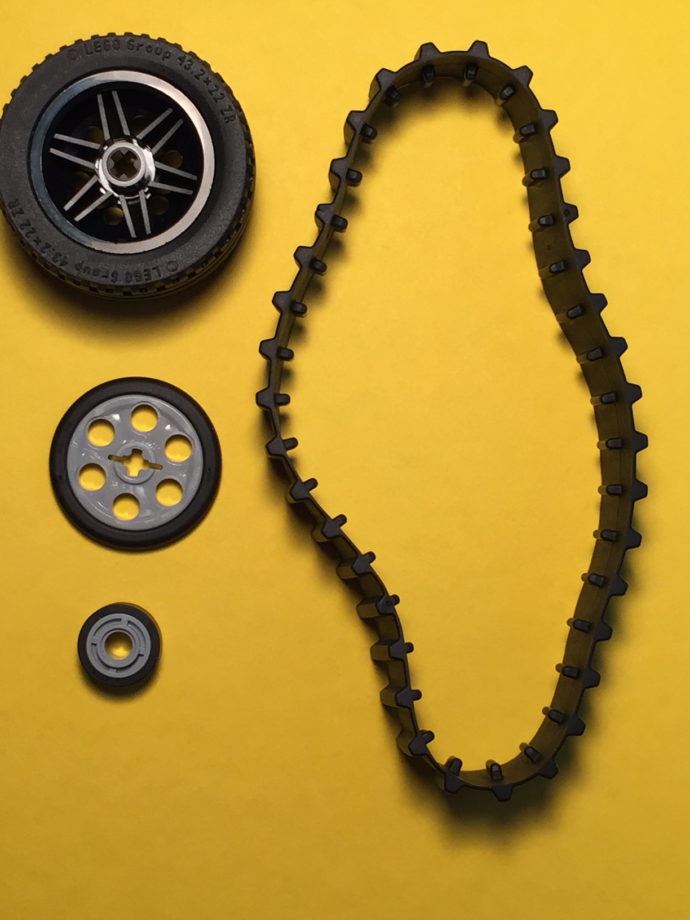
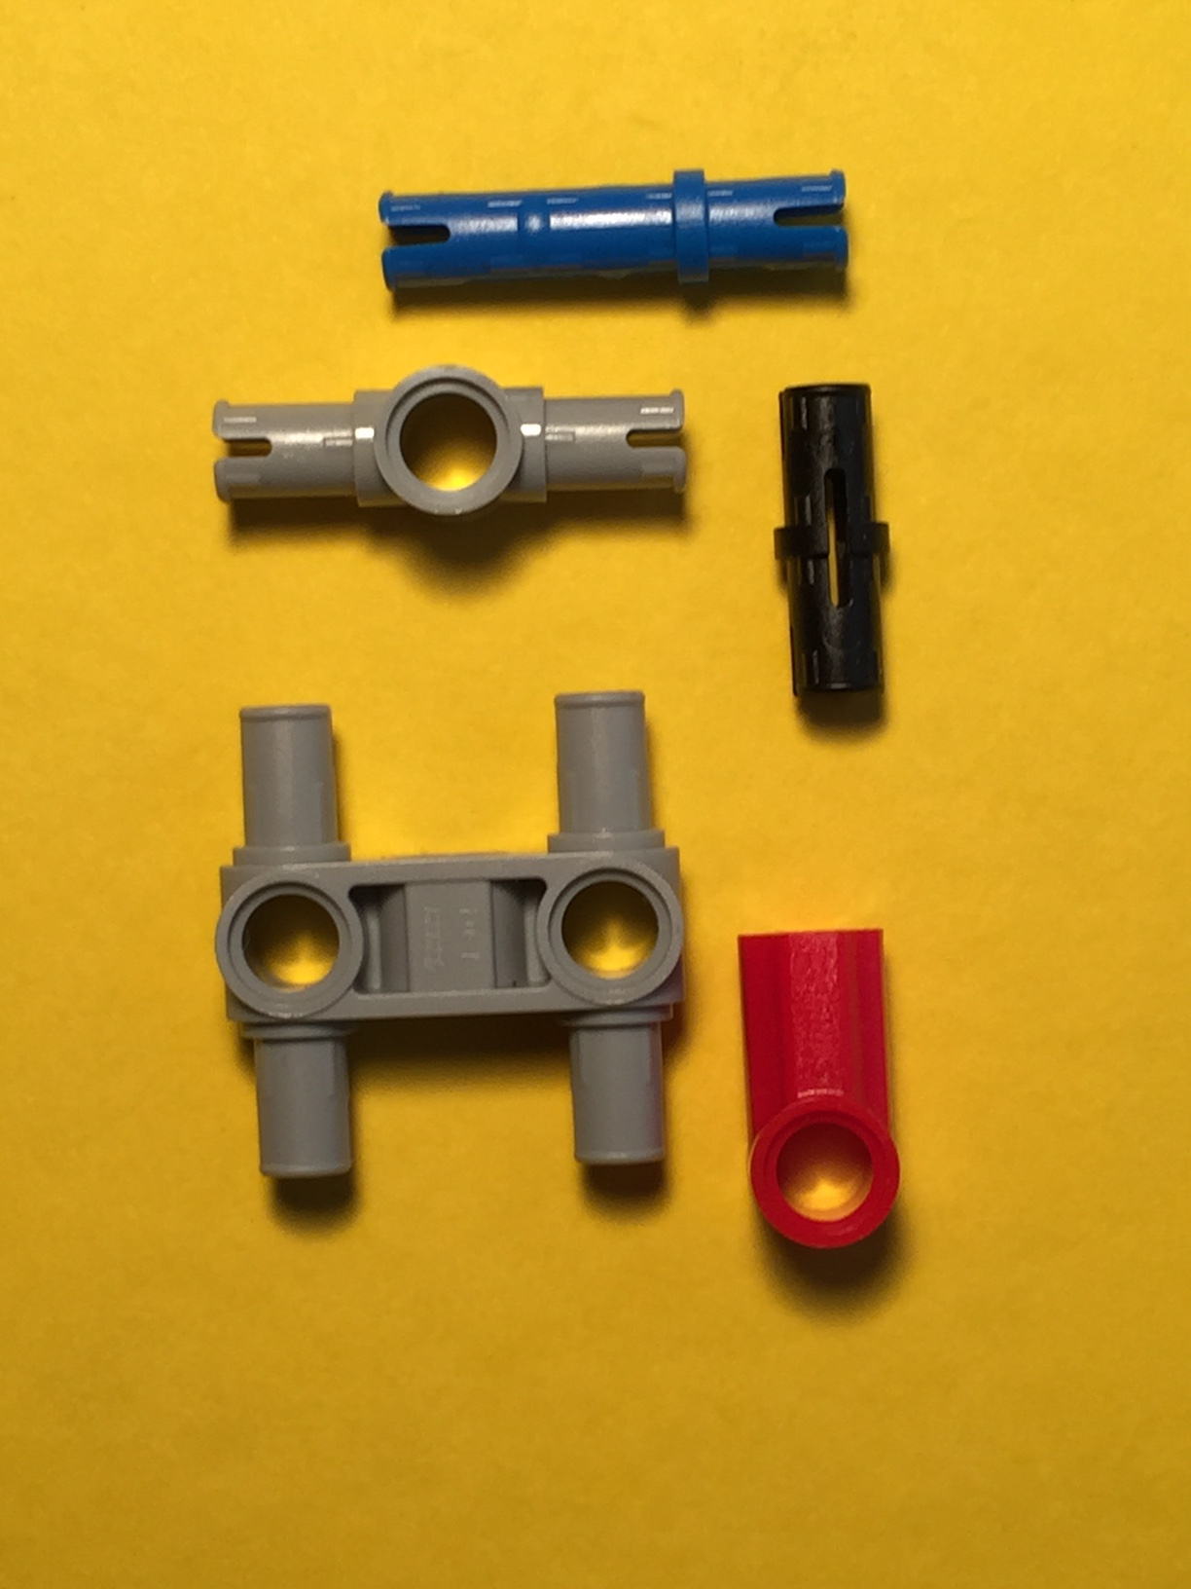
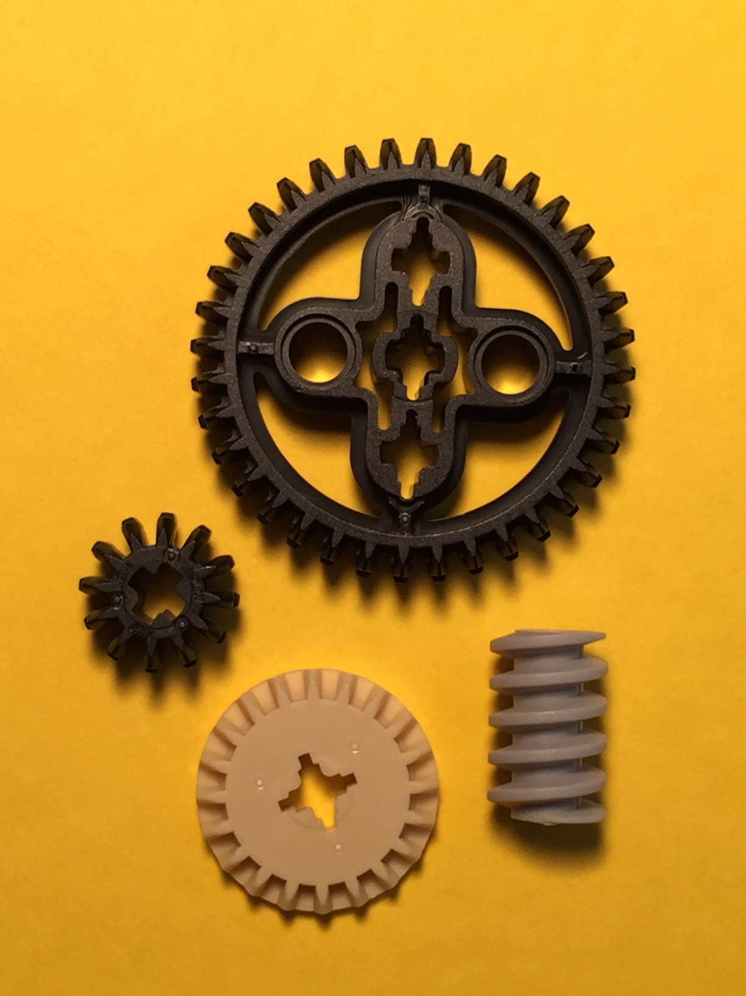
Robotics using EV3
Lego structural elements
Axles
Beams
Wheels & Treads
Connectors
Gears

Slide 13
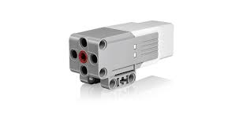
Robotics using EV3
Motors
Large motor:
– Higher Torque (power) but slower speed
- Axle is perpendicular to motor
Medium motor
– Lower Torque but higher speed
- Axle goes through the motor

Slide 14
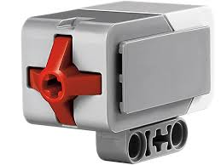
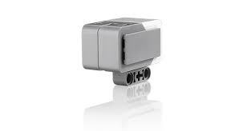
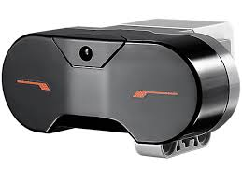
Robotics using EV3
Sensors
Touch
Ultrasonic
Gyro
Color
Infrared

Slide 15
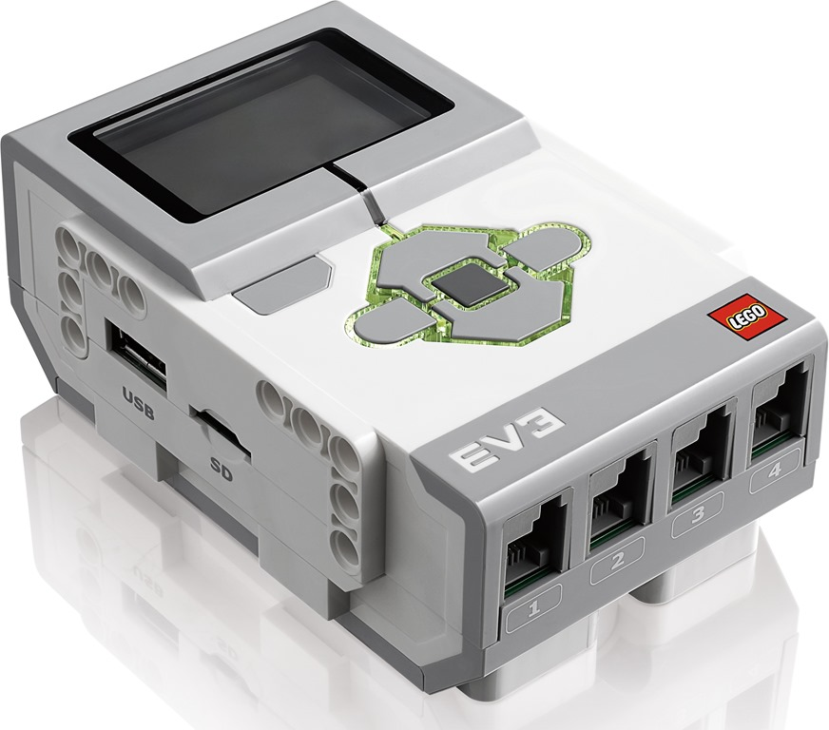
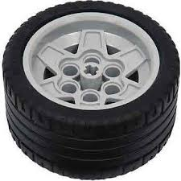
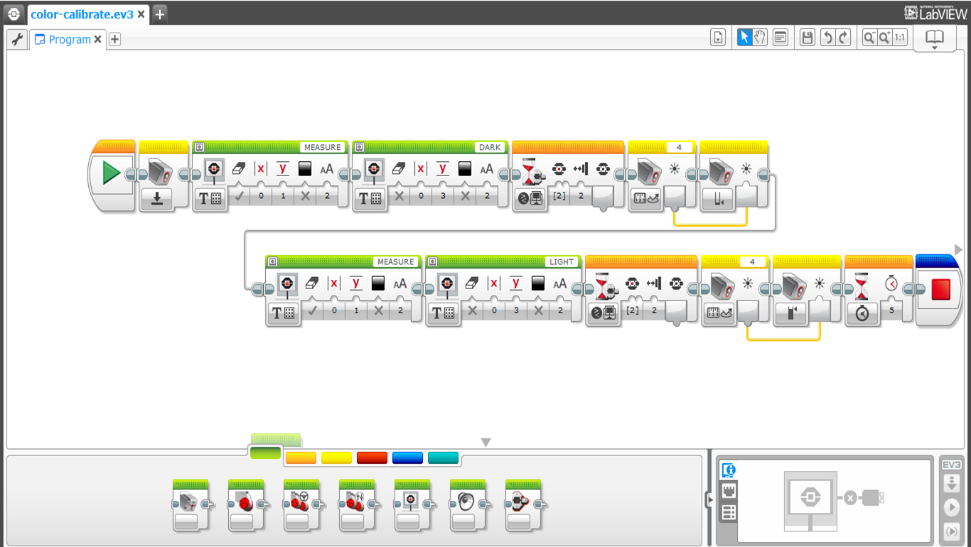
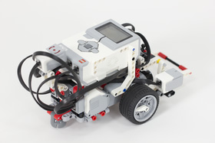
Robotics using EV3
Putting it all together…
Take an EV3 Brick
Build a chassis with Lego Structural elements, motors and wheels
Use EV3 software to program it to perform the desired action and download the program to the brick
Select the program and run it!

Slide 16
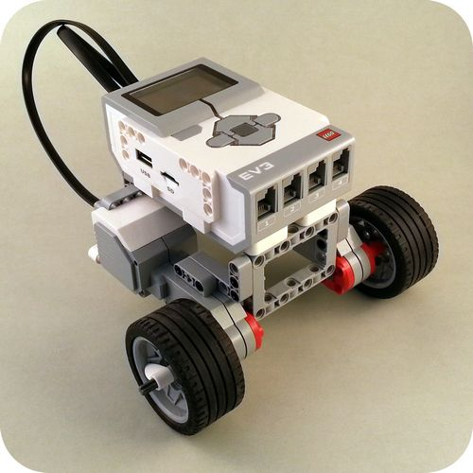
Robotics using EV3
Building your first EV3 Robot
RilelyRover
Build instructions from
http://www.damienkee.com/home/2013/8/2/rileyrover-ev3-classroom-robot-design.html

Slide 17
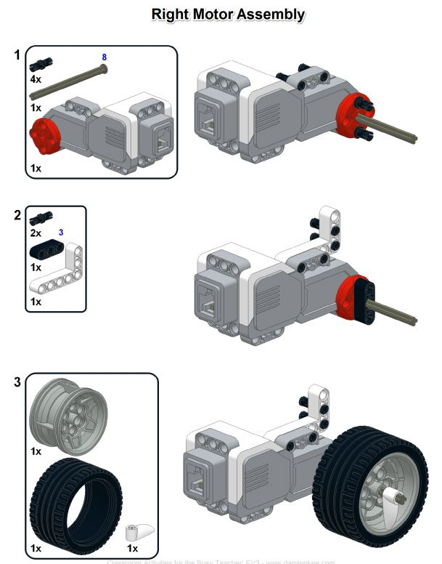

Slide 18
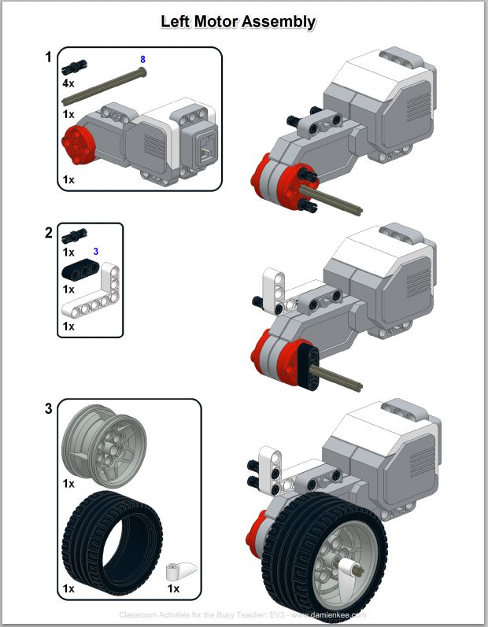

Slide 19
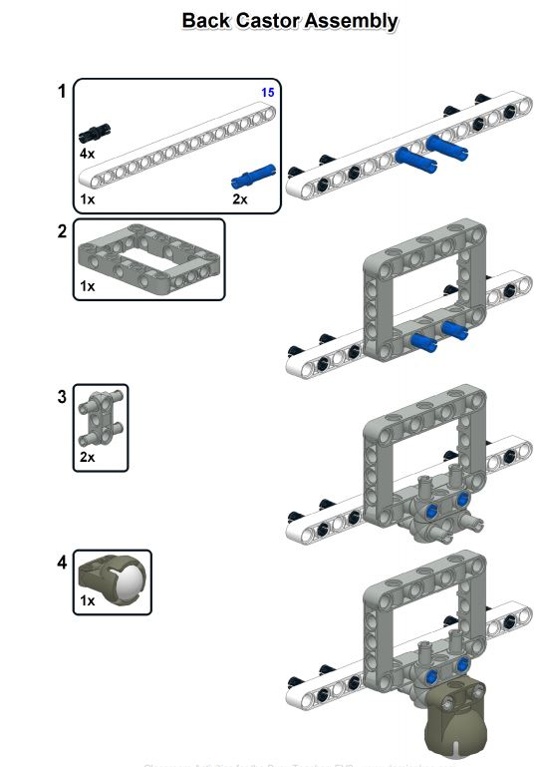

Slide 20
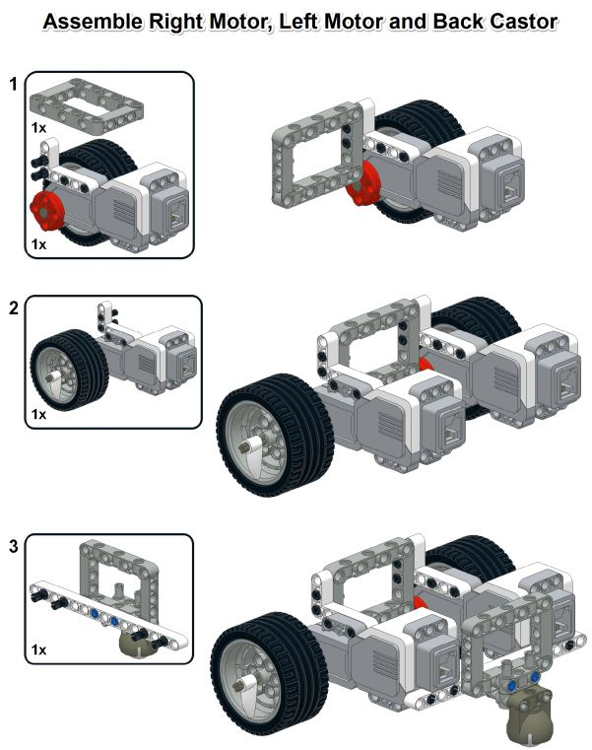

Slide 21
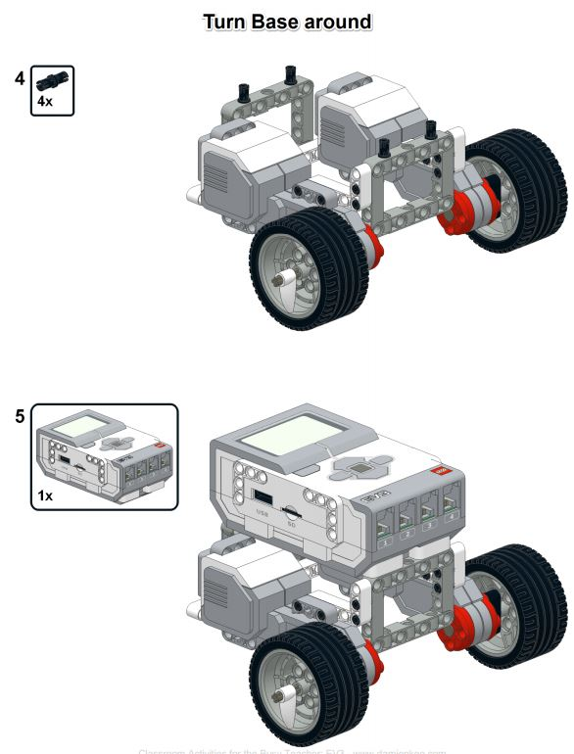

Slide 22
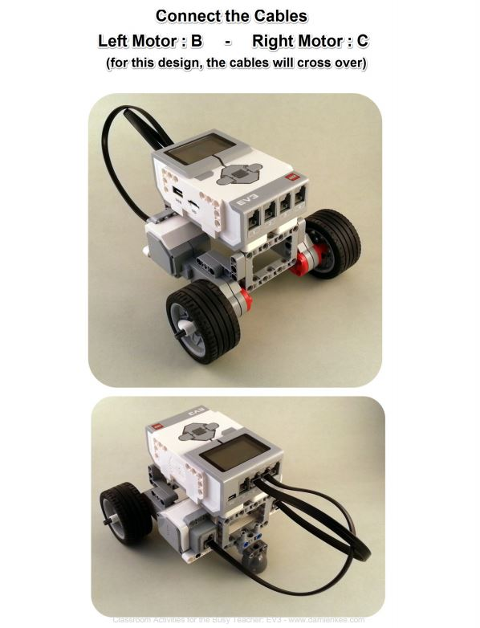

Slide 23
Robotics using EV3
Basic EV3 programming
Moving forwards and in reverse
Turns – Swing and Pivot turns
Wait block
Loop control
Challenge program

Slide 24
Moving Forwards
Both motors move in forward direction at the set speed for specified # of rotations
Motors selected
Speed Setting
FRONT
How far should we go?
(1 rotation selected)
Movement Selection

Slide 25
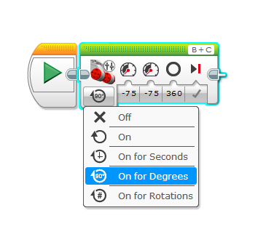
Moving Backwards
Both motors move in reverse direction at the set speed for specified # of degrees
Motors selected
Speed Setting
(note negative values)
FRONT
Movement Selection
How far should we go?
(360 degrees selected)

Slide 26
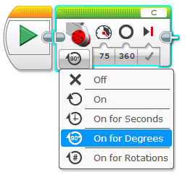
SwingTurn
Swing turn is done by moving one motor forward while the other is stationary
FRONT
FRONT
Note that degrees are not geometrical degrees of turn of the robot but degrees of rotation of the motor
(360 degrees = 1 rotation)

Slide 27
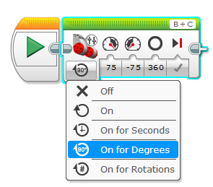
Pivot Turn
Pivot turn is done by moving one motor forwards and the other motor backwards
Speed Setting
(note B is + and C is -)
Pivot point
FRONT
FRONT

Slide 28
Wait till Button#2
Turn B+C motors ON
Wait for button #2 (middle button) to be pressed

Slide 29
Touch Sensor
Touch Setting
0 = Released
1 = Pushed
2 = Bumped

Slide 30
Wait till Touch
Turn B+C motors ON
Wait for touch sensor to be pressed
(Touch sensor is on port 2)

Slide 31
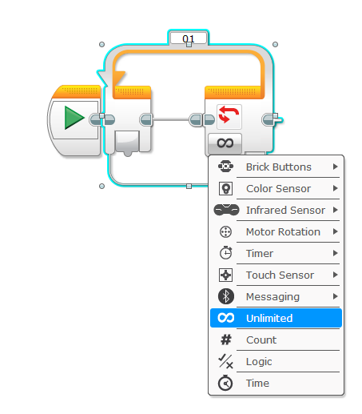
Loop Control
Use a loop to allow repeating a set of instructions based on different criteria listed below
Loop Until…

Slide 32
Challenge
Program the robot to move forward continuously at 40% power. Every time it hits an obstacle as indicated by a touch sensor, the robot should move back one rotation, turn at about 120 degrees and continue. Robot should stop after 10 bumps.

Slide 33
Challenge
Here’s one way to solve this challenge…

Slide 34
Robotics using EV3
Acknowledgement:
Web resources…
Legomindstorms.com
Bricklink.com
http://www.damienkee.com/home/2013/8/2/rileyrover-ev3-classroom-robot-design.html

